Slide 1
Hashi solver rules

Slide 2
Initial Rule
Used at the start of the solving process.

Slide 3
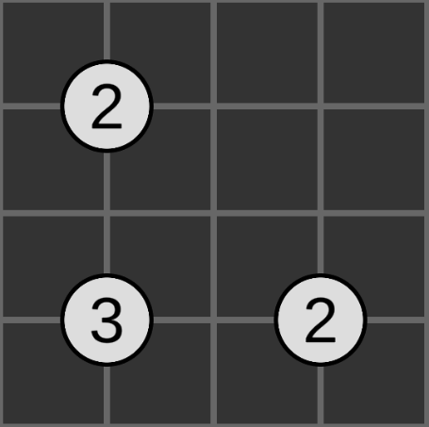
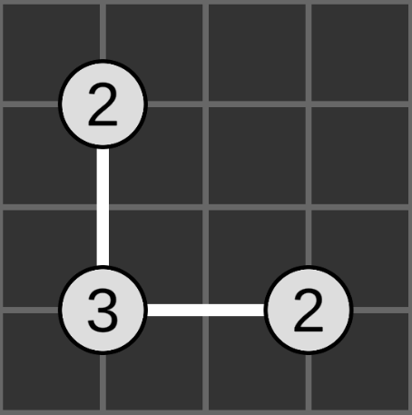
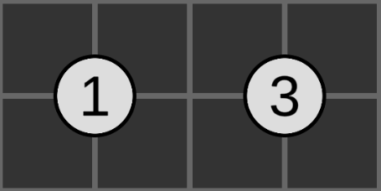
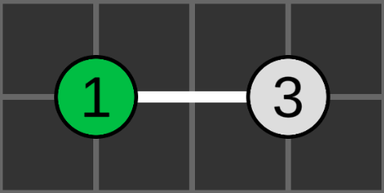
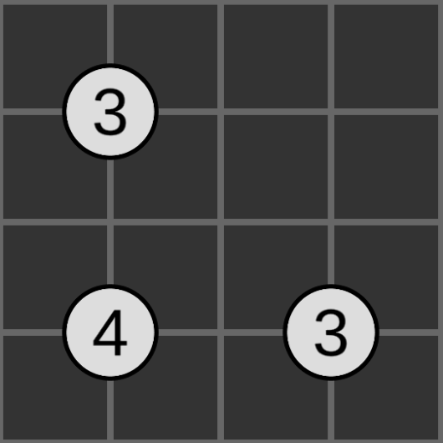
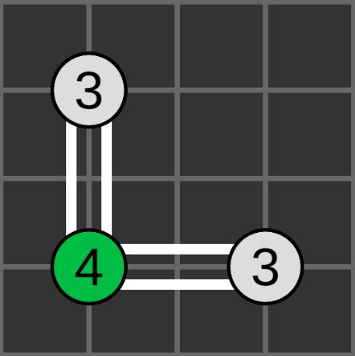
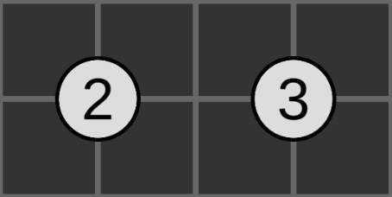
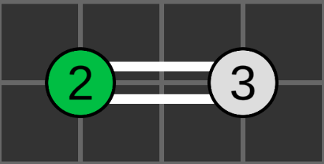
Initial Rule

Slide 4
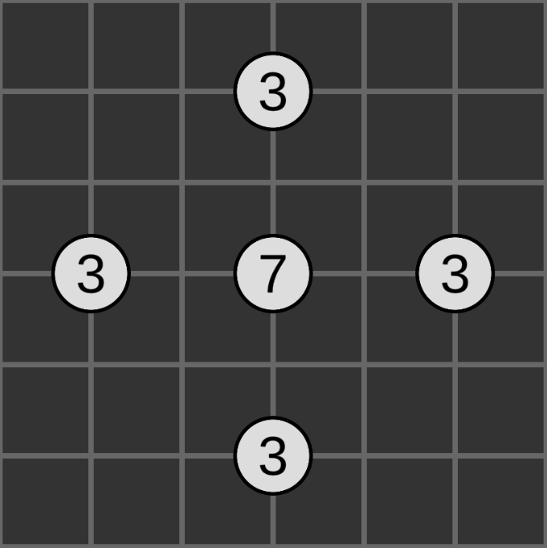
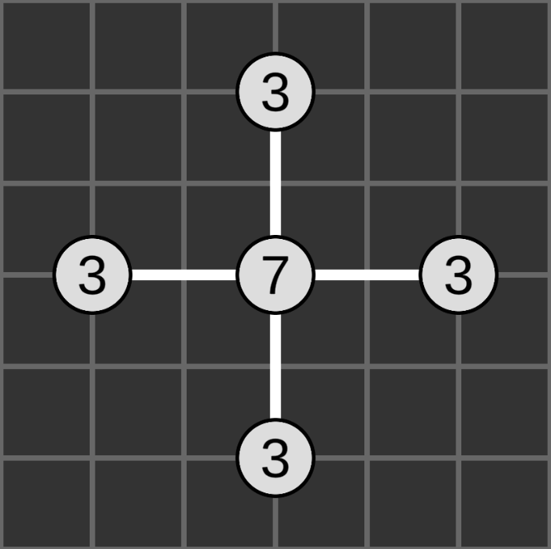
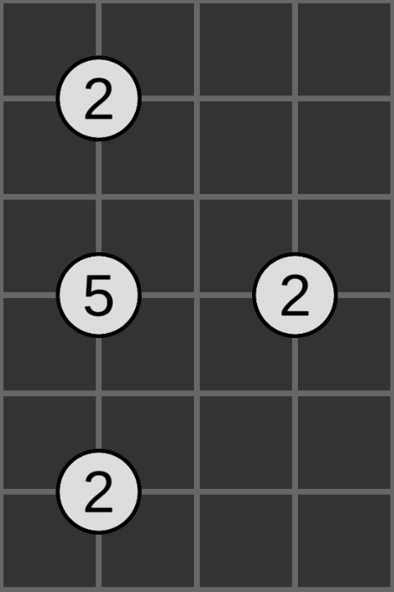
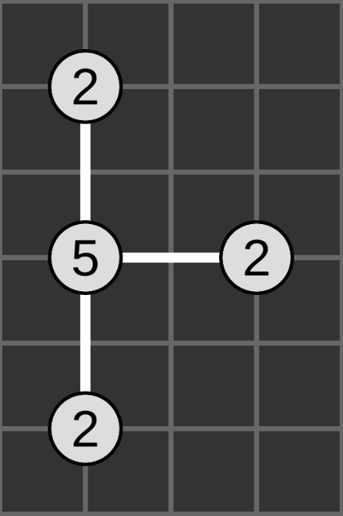
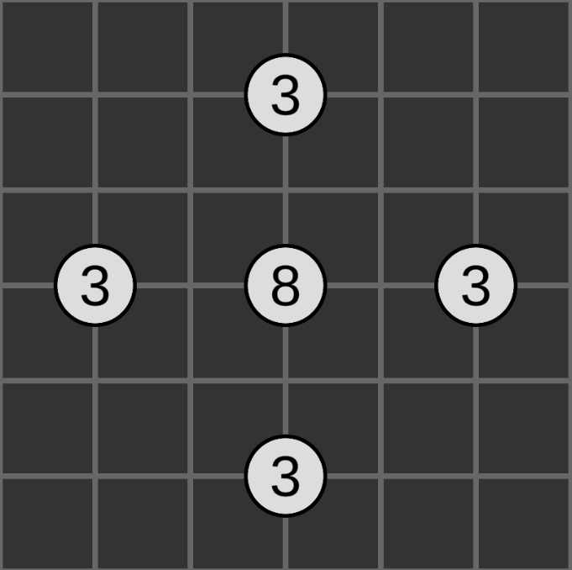
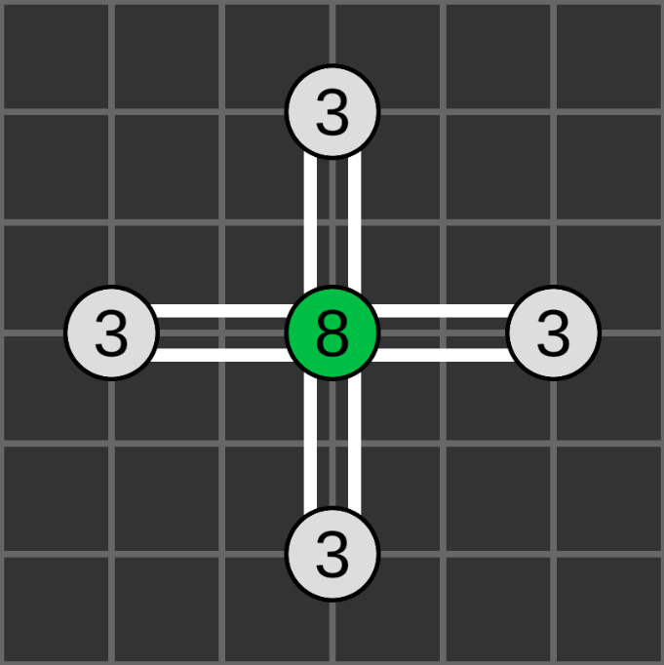
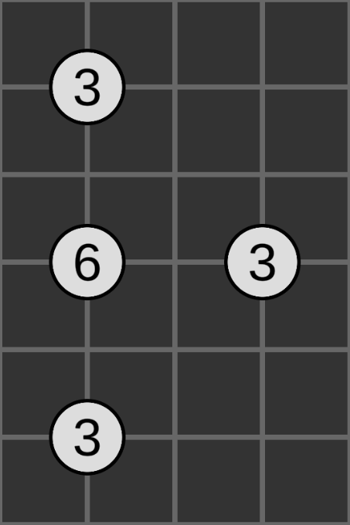
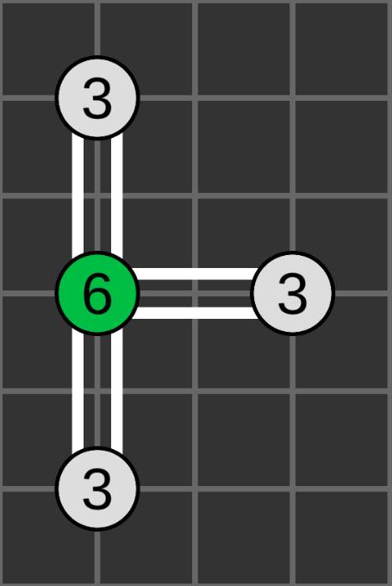
Initial Rule

Slide 5
Initial Rule
if nodeValue is even and neighbourCount == nodeValue / 2:
connect two bridges to each neighbour
if nodeValue is odd and neighbourCount == (nodeValue + 1) / 2:
connect one bridge to each neighbour

Slide 6
One Neighbour Rule / Iterative Rule
Used once the initial rule has finished.

Slide 7
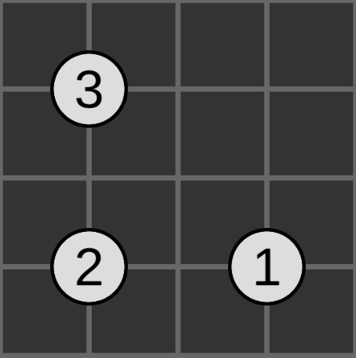
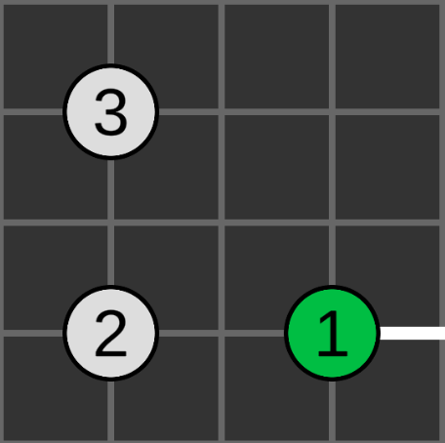
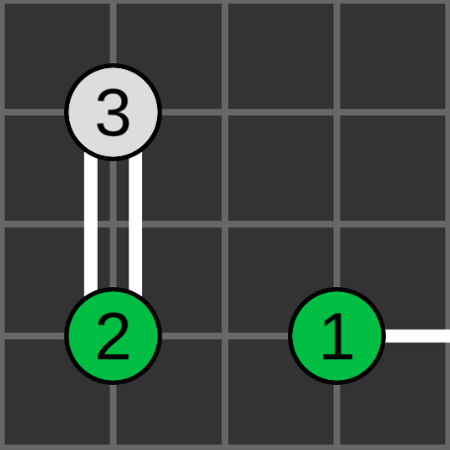
One Neighbour Rule / Iterative Rule
Node with value 2 has 2 neighbours.
One node becomes full by connected to a node elsewhere.
Node with value 2 must connect to its last neighbour.

Slide 8
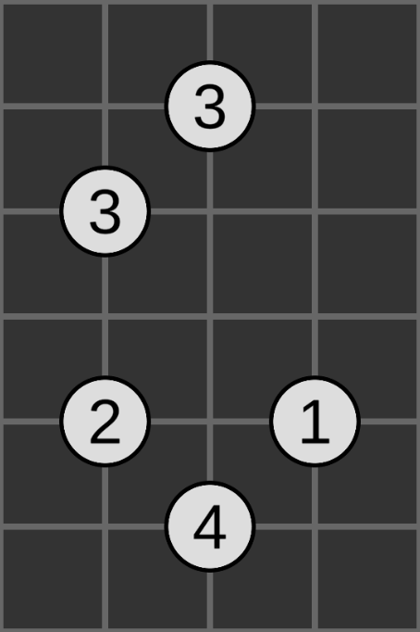
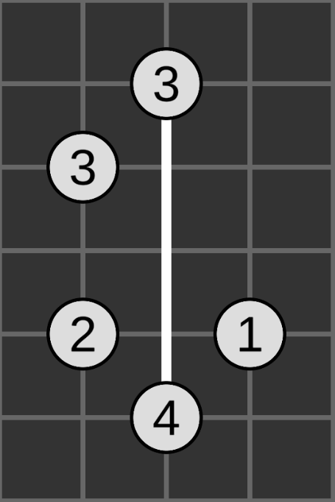
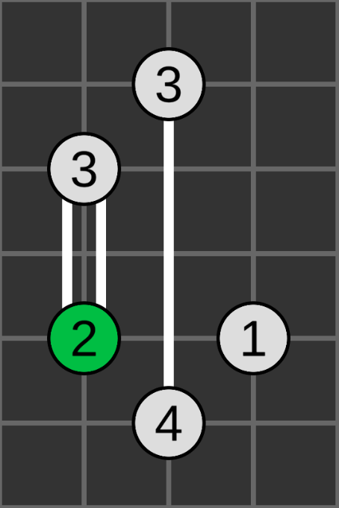
One Neighbour Rule / Iterative Rule
Node with value 2 has 2 neighbours.
One neighbour is blocked off by a bridge.
Node with value 2 must connect to its last neighbour.

Slide 9
Redo Initial Rule
Used when a node becomes full.
Whenever a node becomes full (meaning that it has the correct number of bridges attached), redo the initial rule on all its non-full neighbours.

Slide 10
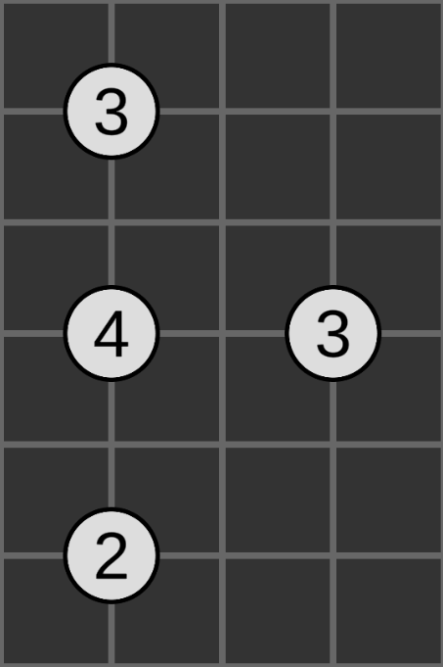
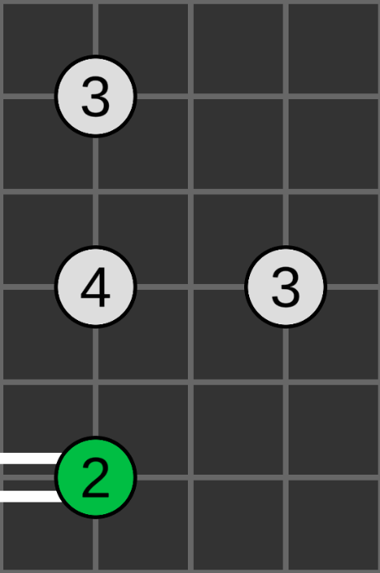
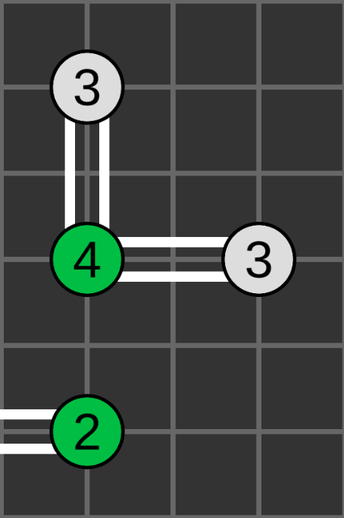
Redo Initial Rule
One of its neighbours becomes full so it has only 2 available neighbours left.
Node with value 4 is treated as if it has 2 neighbours and does initial rule again.
Node with value 4 has 3 neighbours so cannot do initial rule.

Slide 11
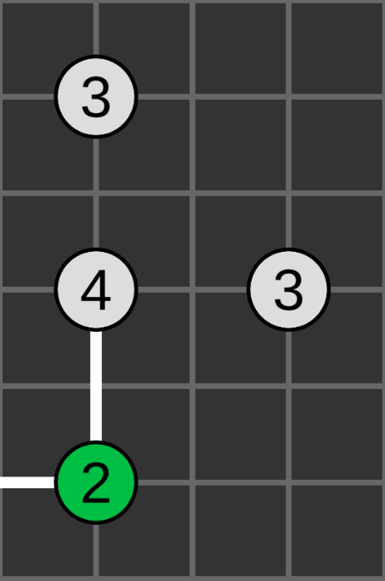
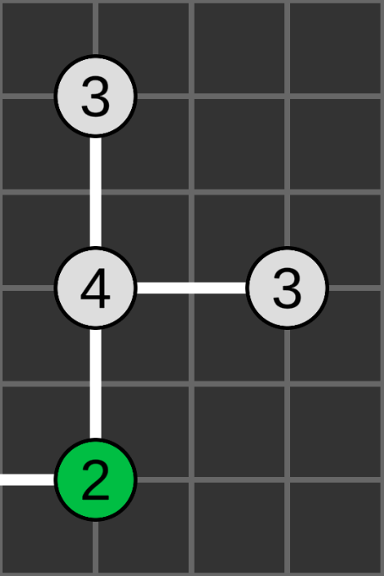
Redo Initial Rule
Node with value 4 is treated as if it a value of 3 and has 2 neighbours and does initial rule again.
One of its neighbours becomes full so it has only 2 available neighbours left.
Node with value 4 has 3 neighbours so cannot do initial rule.

Slide 12
Backtracking Rule
If iterative rule iterates through every node and makes no changes, use backtracking rule.

Slide 13
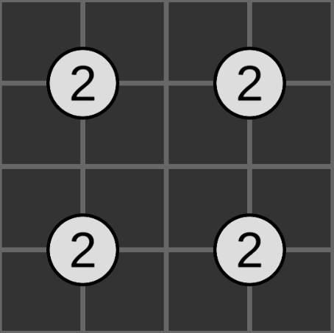
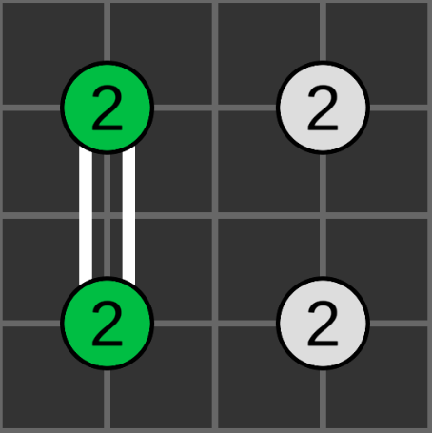
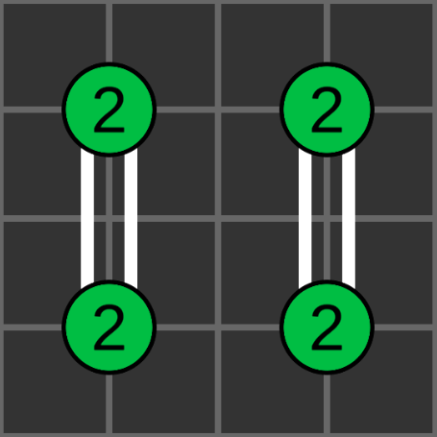
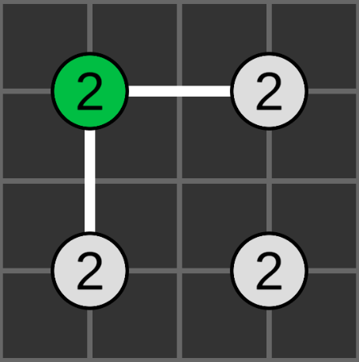
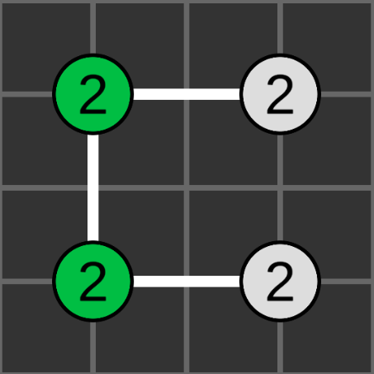
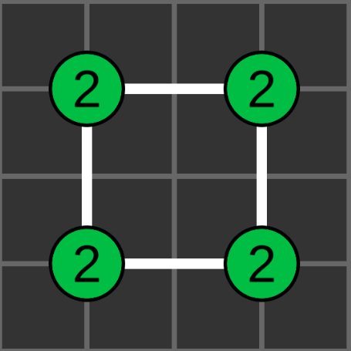
Backtracking Rule

